Slide 1



Biderictional
search algorithm
START!
Under The Supervision Of
Dr/ Mohamed Rehan

Slide 2
Bidirectional Search Algorithm
A graph traversal algorithm that runs two simultaneous searches one forward from the start and one backward from the goal meeting in the middle. It greatly reduces explored nodes, making it faster and more memory-efficient. Used in AI pathfinding, GPS routing, and network optimization.

Slide 3


how bidirectional search work:
1-Initialization
2-Search Expansion
Create two frontiers one at the start node and the other at the goal node
Add all unvisited neighbors to the respective frontier.
Track visited nodes to avoid duplication.
3-Intersection Check
4- Path Construction
After every expansion step, check whether any node appears in both visited sets. If found, the two searches have intersected a path has been found
Construct the full path by combining the path from the start to the meeting point and from the goal to the meeting point (in reverse).

Slide 4


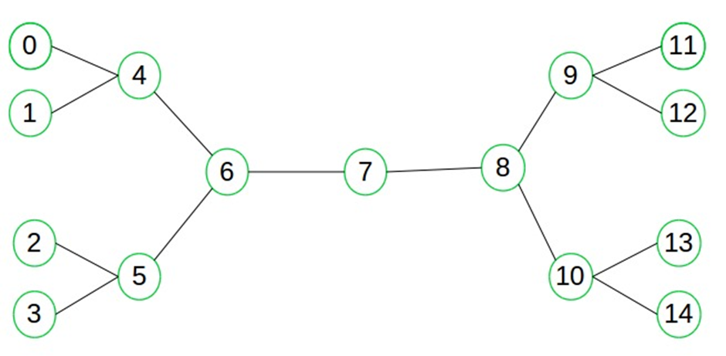
Example

Slide 5


solution
initial Setup
Forward Frontier(from 0): {0}
Backward Frontier (from 14): {14}
Visited (forward): {0}
Visited (backward): {14}

Slide 6


solution
step 1
From 0 → neighbor is 4
Forward Frontier: {4}
Visited (forward): {0, 4}
From 14 → neighbor is 10
Backward Frontier: {10}
Visited (backward): {14,10}

Slide 7
solution
Step 2
From 4 → neighbors: {1, 6, 0}
Add 1 and 6 (0 already visited)
Forward Frontier: {1, 6}
Visited (forward): {0, 1, 4, 6}
From 10 → neighbors: {8, 13, 14}
Add 8 and 13
Backward Frontier: {8, 13}
Visited (backward): {10, 13, 14, 8}

Slide 8
solution
Step 3
From 1 → neighbor is 4 (already visited)
From 6 → neighbors: {4, 5, 7}
Add 5 and 7
Forward Frontier: {5, 7}
Visited (forward): {0, 1, 4, 5, 6, 7}
From 8 → neighbors: {7, 9, 10}
Add 9 (7 and 10 already visited)
Backward Frontier: {13, 9, 7}
Visited (backward): {8, 9, 10, 13, 14, 7}

Slide 9

FOUND IT !
Meeting Point Found: Node 7
Node 7 is now in both forward and backward visited sets.
Trace the Full Path
From start (0):
0 → 4 → 6 → 7
From goal (14):
14 ← 10 ← 8 ← 7→ reversed becomes 7 → 8 → 10 → 14
Final Path from 0 to 14
0 → 4 → 6 → 7 → 8 → 10 → 14
Total steps: 6

Slide 10

Evaluation
1. Completeness:
Yes, the algorithm is complete if the graph is finite and a path exists.
2. Optimality:
Yes, optimal if both directions use BFS in unweighted graphs or UCS in weighted graphs.
3. The time complexity of bidirectional search is O(b^d/2)
b = branching factor
d = depth of the solution
4. The space complexity of bidirectional search is also O(b^d/2).
Memory usage is higher due to storing two frontiers and visited sets, but still significantly more efficient overall in many scenarios.

Slide 11
Real Life Example

Slide 12

A common real-world use case of bidirectional search is in Google Maps or other GPS-based routing systems. When calculating the shortest driving route from your current location to a distant destination, bidirectional search can optimize performance by exploring the road network from both ends (start and goal). This significantly reduces the time and memory needed to find the optimal path, especially in large cities with complex road systems.

Slide 13
BIDIRECTIONAL SEARCH ALGORITHM
PROS
CONS
Reduces search time drastically.
More efficient in sparse graphs with large branching factors.
It often requires less memory than traditional algorithms like BFS, especially in densely connected graphs or large search spaces.
Requires the ability to reverse actions.
the user should be aware of the goal state
Implementation complexity increases with state comparison and path reconstruction.

Slide 14

Our Team
1
Malak Mounir Abdellatif 231903643
2
Razan Ahmed Fawzy 221903165
3
Farida Waheed Abdelbary 221903168
4
Nour Hesham El-Sayed 221902960
5
Nourhan Farag Mohamed 231903707

Slide 15

Thank You
ANY QUESTIONS?

